Slide 1
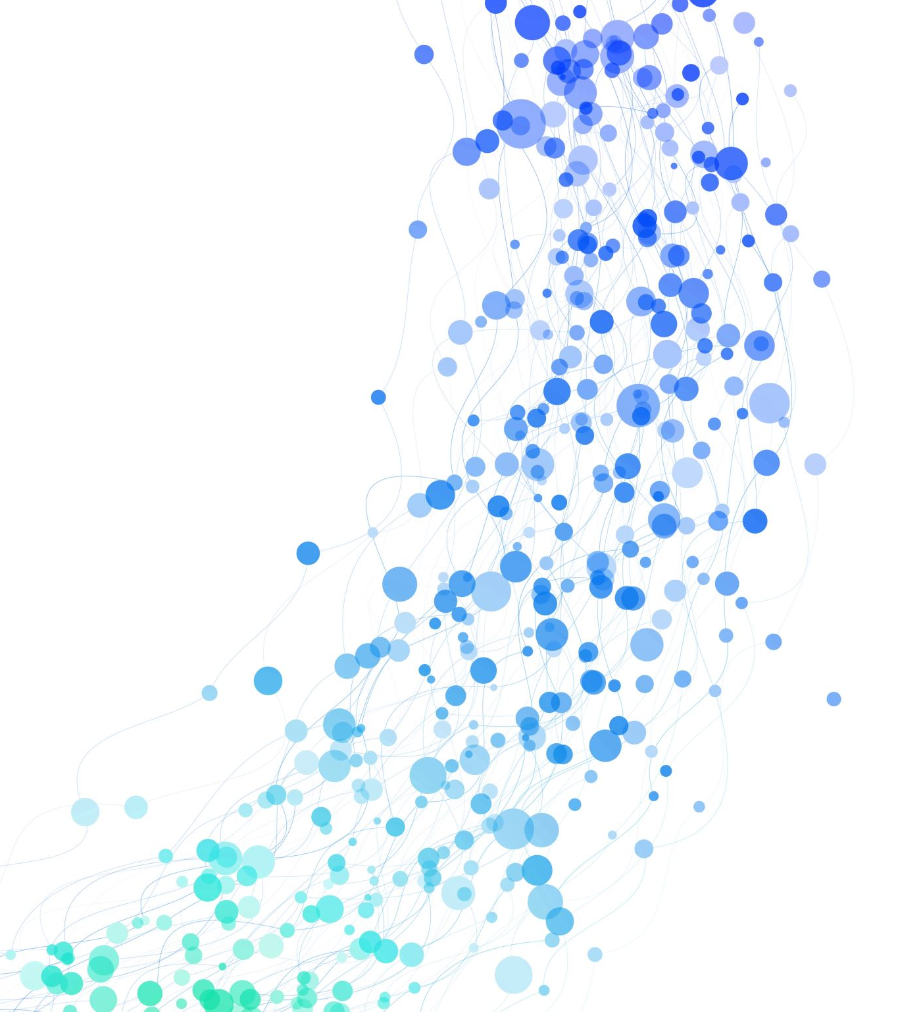
Melting The Ocean Of An Icy Moon
Team: The Crying Genies
Hackers: Jesse Sutherland and Yuqing (Susan) Zhou

Slide 2
Why are there liquid oceans under the ice?
Evidence has been found that indicates the existence of oceans on Europa and Enceladus, which are respectively the moons of Jupiter and Saturn.
These moons have existed in the frosty reaches of our solar system long enough for all the residual heat from their creation to have escaped into space. So why are there oceans on those icy moons?
One of the possible reasons is tidal heating. [1]

Slide 3

Melting the Ice with Tides
“It’s easier to keep an ocean around and maintain it, rather than freeze and remelt it.” [1]
Our approach, however, is to let the ocean be completely frozen at first and simulate the process of remelting it.
Tidal Heating:

Slide 4
Melting the Ice - Visualization
The melting starts from the most inner layer of ice and then spreads outwards.

Slide 5
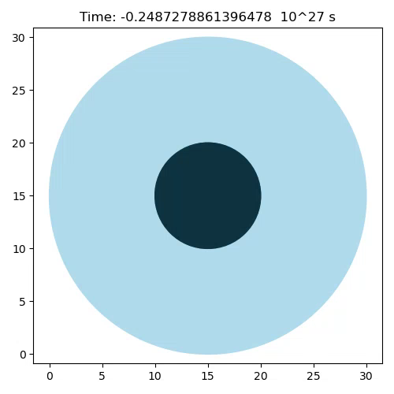

Slide 6
Future Directions
Revise the model to get more realistic values:
Take into account the continuous heat flow through the “layers”.
Simulate the orbits to derive the heating rate equation.
Add other factors such as radioactive heating to the model.

Slide 7
[1] R. G. Andrews. These Moons Are Dark and Frozen. So How Can They Have Oceans? Quanta Magazine, 2023.

